Slide 1
ERASMUS +
WE GROW DIGITALLY
POLAND
The second mobility – 25th-30th Bulgaria

Slide 2
Our school’s full name is: Primary School number 1 in Marki of Kornel Makuszyński.
In Marki there are 5 public primary shools and 2 private school.
The pupils star education at the age of 7 years and finisz at the end of 15years old.

Slide 3
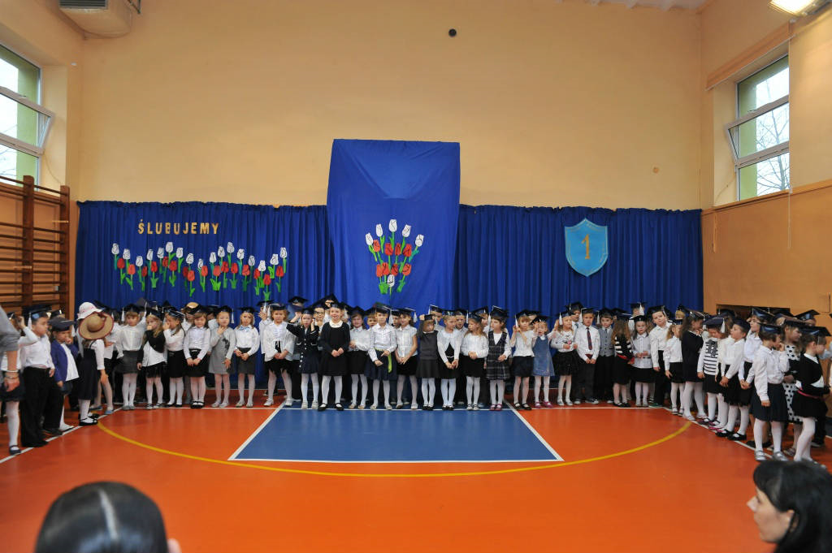
Over 900 students attend to our school and over 80 teachers work here
The beginning and the ending of the school year are the most important days when students and teachers gather in school sports gym to celebrate. They listen to the speech given by the headmaster Mrs Danuta Pazikowska and local municipalities. Special meetings are also organized because of national events.

Slide 4
Our teachers use an electronic register system called „Librus”.
Every teacher, parent and student has got an access to electronic register. It helps to monitor learning progress and attendance of the lessons, the time of predicted tests and changes in the lessons as well.

Slide 5
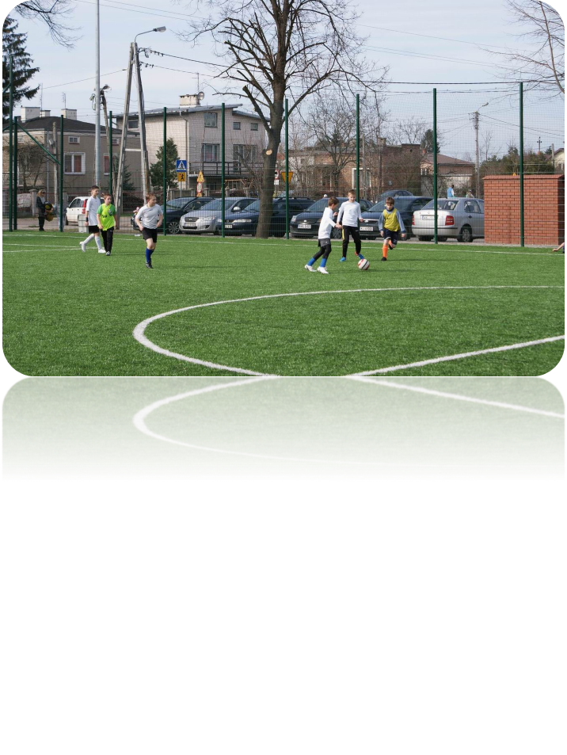
Our Gym can be shared with three classes, it has huge curtains, which divide it into three sections. On P.E. we play sports like handball,volleyball,football and many more!

Slide 6
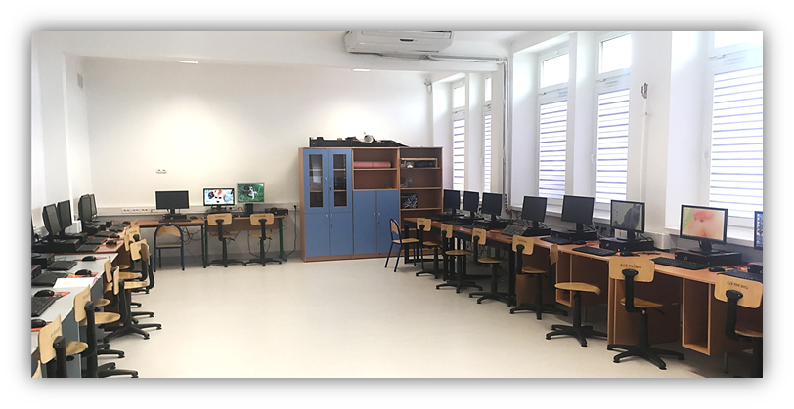
We have two ICT. Classrooms.

Slide 7
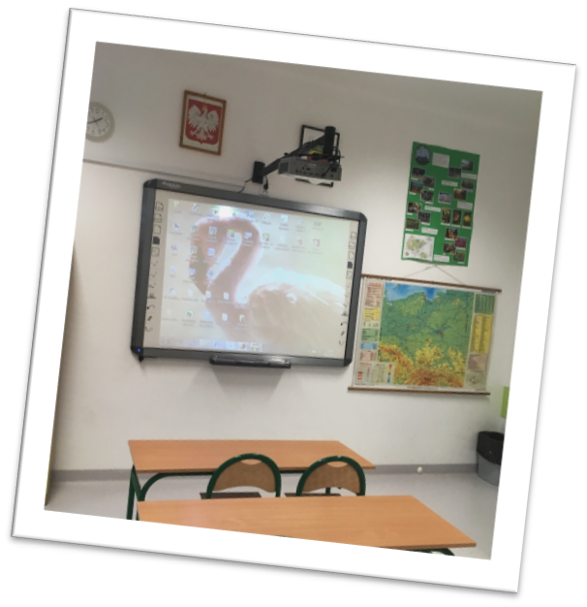
And a SCIENCE AND BIOLOGY CLASSROOM
Using interactive whiteboard is an excellent way to present some natural phenomena and scientific experiments. Thanks to special software strictly connected with the students book the lessons are curious and fascinating.

Slide 8
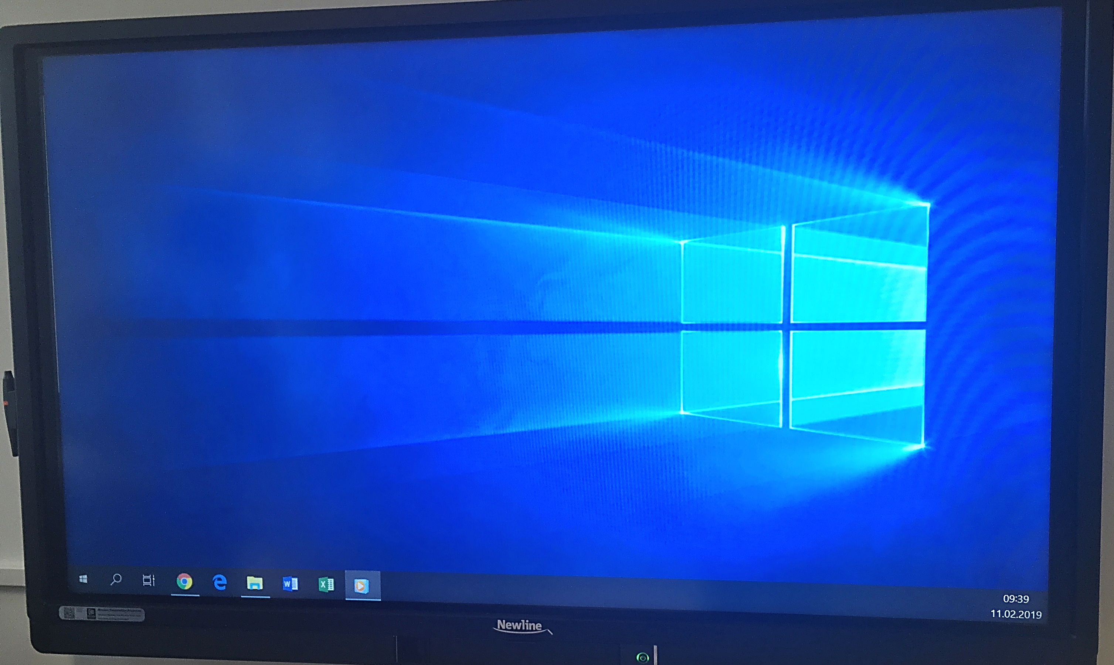
There is at least one board in every classroom: a chalk board, a marker board or a multimedia board

Slide 9
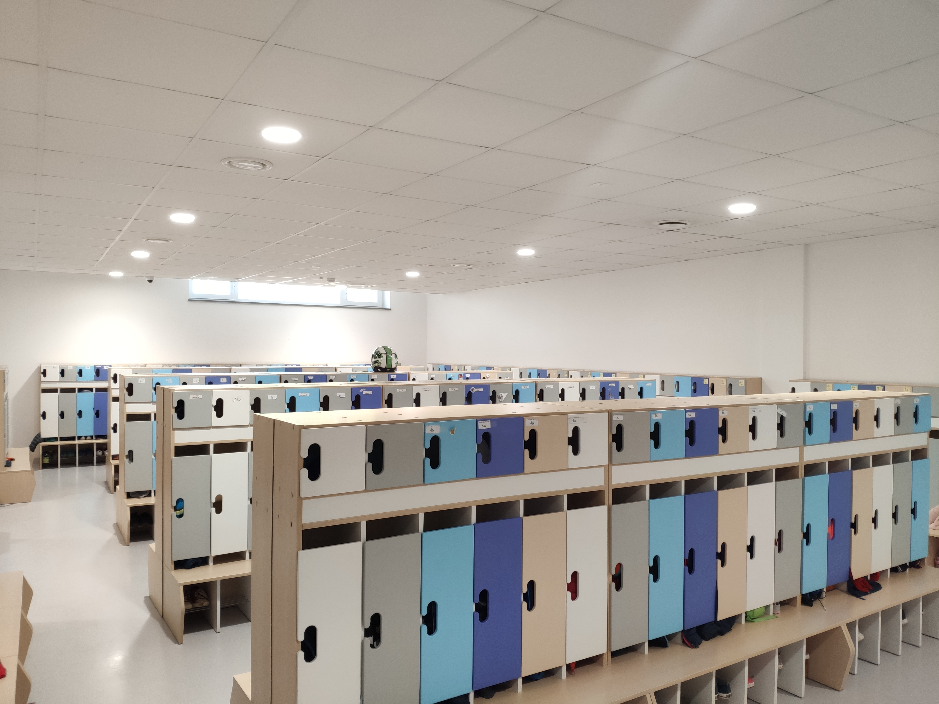
wE hAve a PRETTY BIG LOCKER ROOM with a Locker for every student
Locker rooms are obligatory for every student and separated for younger and older classes.

Slide 10
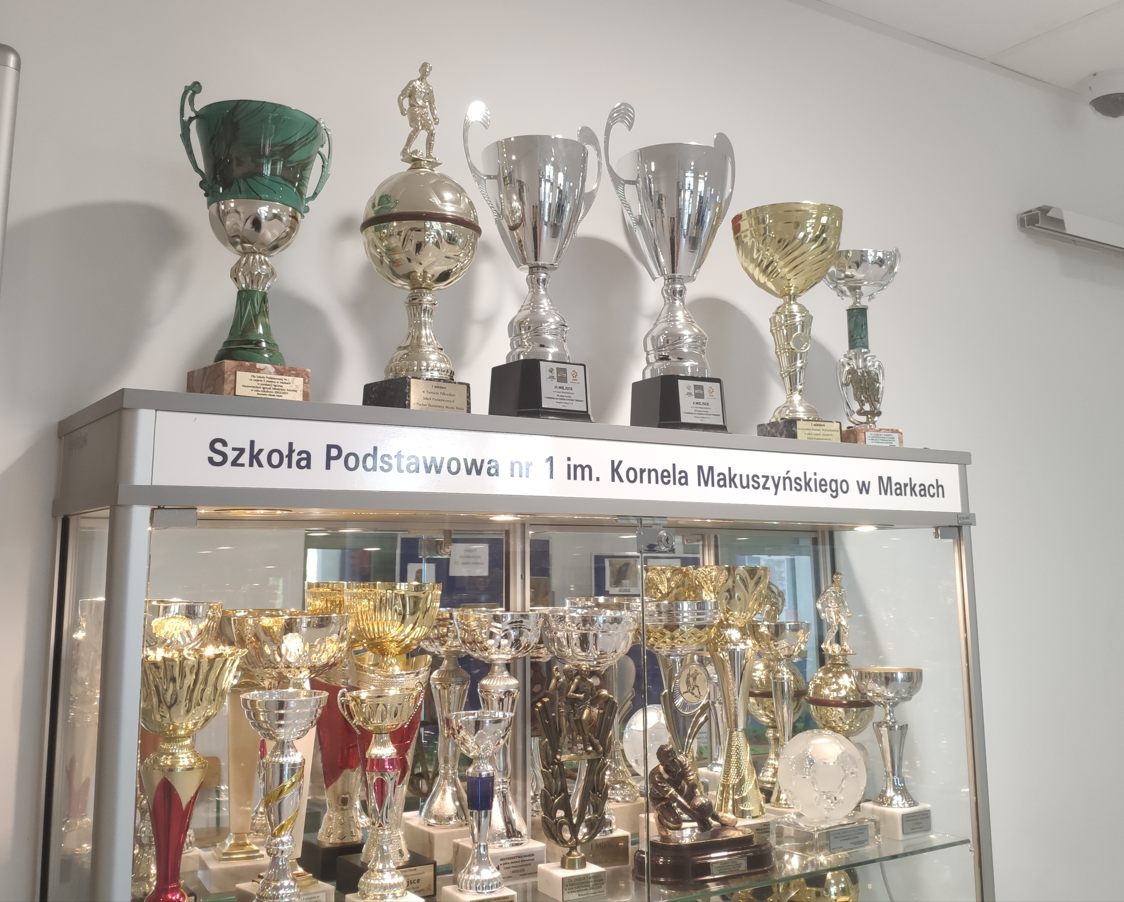
Our school won many tournaments and prizes
Students in SP1 Marki take part in various sports competitions and they win many prizes. One of the most popular game is handball, basketball and football. Besides, our students are talented in Art., singing and dancing. One of the girls took part in TV talent show this year. We have also school talent shows organized every year and they are really popular among students.

Slide 11
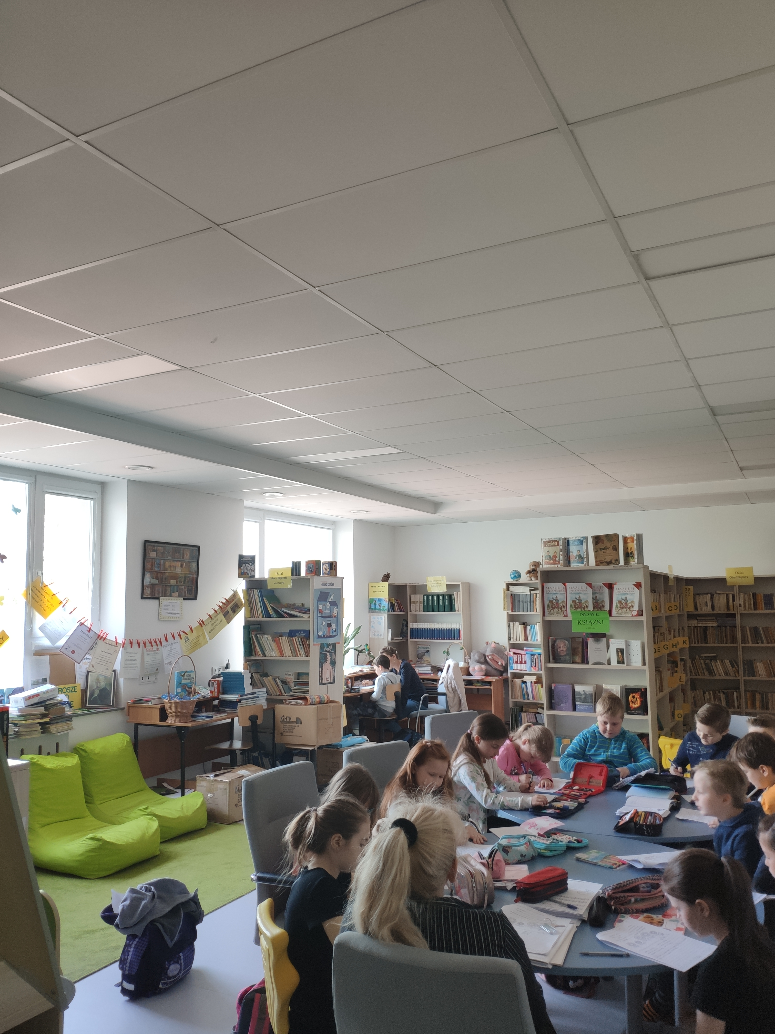
our LIBRARY is STUFFED WITH MANY INTERESTING BOOKS
In the school library we can find not only obligatory set books but also books connected with different topics and interests. Additionally, students books for every subjects are stored in the library. Every year students borrow them and give tchem back at the end of every school year. Parents don’t have to buy books for their children because they are provided by the school.

Slide 12
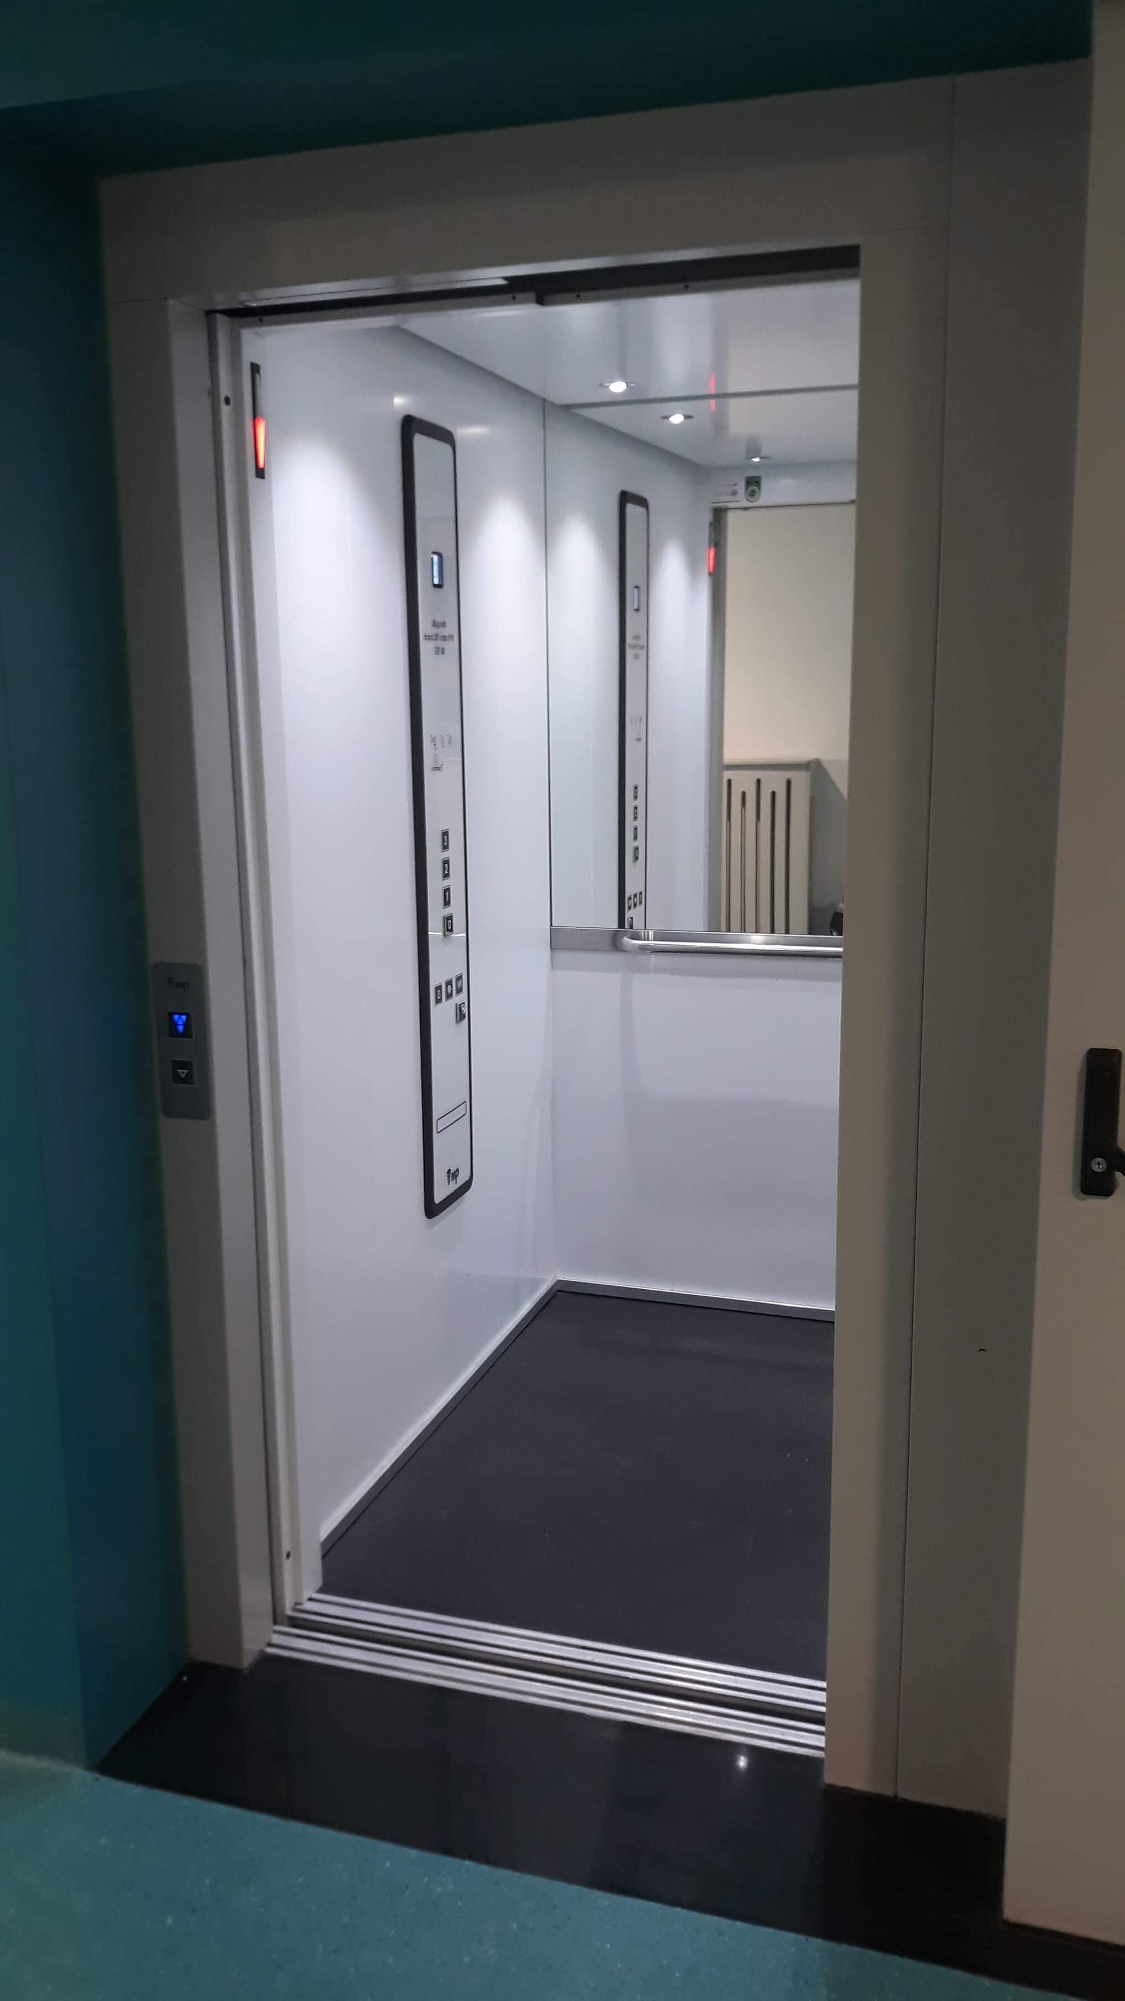
We also have AN ELEVATOR FOR INJURED OR DISABELED CHILDREN
This device is extremely useful not only for disabled children but very often for children with some injuries after small accidents having problems with mobility. The school is a two storey building and every lesson is in a different classroom that, why students and teachers have to change rooms every break.

Slide 13
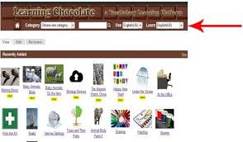
WE USE PLENTY OF EDUCATIONal PROGRAMS and apps

Slide 14
WE LEARN ABOUT CYBERBULLYING THROUGHT SERIES CALLED ,,SIECIAKI’’
IF NEEDED WE USE ALL KINDS OF E-BOOKS

Slide 15
Digi clubs
Students engaged in the project „We grow diigtally” and any student interested in technology can take part in Digi club sessions organised once a week. These classes are conducted after the regular lessons in the schoool IT lab. During this time participants can try new learning apps and get some knowledge about coding.
There are two groups for younger and older students. Besides, after the lessons students can go to robotics activities.

Slide 16
Thank you for your attention

